Slide 1
Topics to be covered :
UNIT-3. LINKED Lists
1. Genaral Linear List : Basic operations, Implementations : Circular linked lists and doubly Linked list.
2. Implementations of STACK and QUEUES using Linked Lists.
Upon completion you will be able to
Explain the design, use, and operation on Linked list
Explain the design, use, and operation on circular Linked list
Explain the design, use, and operation on doubly Linked list
Implement a stack and Queue using linked list structure.

Slide 2
1. What is LINKED List ?
2. Why linked list data structure needed?
3. Representation of LInked list
4. Types of Linked lIsts
Circular Linked List and its implementation
Doubly Linked List and its Implementation
5. Basic on operations on Linked List
6. STACK implemetation using Linked List
7. QUEUE implemetation using Linked List
6. Advantages and Disadvantages of Linked list

Slide 3
What is LIST ?
List is an ordered data structure that is used to store different or same set of elements in a sequential manner.
Depending on how they are represented/implemented, We can think of Two types of Lists namely :
Contiguous list - implemented by usually by arrays and structure
Linked List - Implemeted by usually pointers

Slide 4
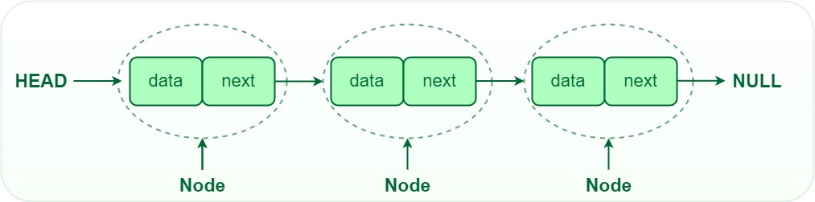
What is LINKED LIST ?
Linked List is a linear data structure, in which elements are not stored at a contiguous, rather they are linked by using pointers.
Linked List forms a series of connected nodes, where each node stores the data and the address of the next node.

Slide 5
Node Structure: A node in a linked list typically consists of two components :
1. Data: It holds the actual value or data
associated with the node.
2. Next Pointer: It stores the memory address
(reference) of the next node in the sequence.
Head and Tail: The linked list is accessed through the head
node, which points to the first node in the list.
The last node Tail node in the list points to
NULL or nullptr, indicating the end of the list.

Slide 6
2. Why linked list data structure needed?
we know that Arrays (i.e. Contiguous List) can be used to store linear data of similar types, but arrays have the following limitations.
The size of the arrays is fixed: So we must know the upper limit on the number of elements in advance.
Also, generally, the allocated memory is equal to the upper
limit irrespective of the usage.
2. Inserting a new element in an array of elements is expensive because the room has to be created for the new elements and to create room existing elements have to be shifted
3. Deleting an existing element in an array is also expensive as we need to shift/move all the elements to cover up the location of the element to be deleted

Slide 7
Illustartive Example :
In a system, if we maintain a sorted list of IDs in an array
id[] = [1000, 1010, 1050, 2000, 2040].
If we want to insert a new ID 1005, then to maintain the sorted order, we have to move all the elements after 1000 (excluding 1000).
Deletion is also expensive with arrays until unless some special techniques are used.
For example, to delete 1010 in id[], everything after 1010 has to be moved due to this so much work is being done which affects the efficiency of the code.

Slide 8
2. Why linked list data structure needed?
Here are a few advantages of a linked list that is listed below, it will help you understand why it is necessary to know.
1. Dynamic Data structure: The size of memory can be allocated or de-allocated at run time based on the operation insertion or deletion.
2. Ease of Insertion/Deletion: The insertion and deletion of elements are simpler than arrays since no elements need to be shifted after insertion and deletion, Just the address needed to be updated.
3. Efficient Memory Utilization: As we know Linked List is a dynamic data structure the size increases or decreases as per the requirement so this avoids the wastage of memory.
4. Implementation: Various advanced data structures can be implemented using a linked list like a stack, queue, graph, hash maps, etc.

Slide 9
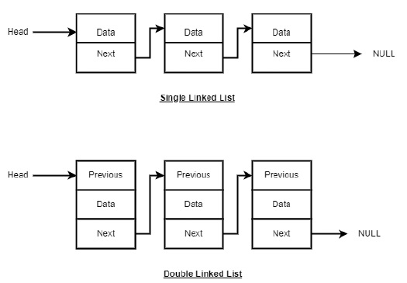
3. Linked List Representation
Linked list can be visualized as a chain of nodes, where every node points to the next node.
As per the above illustration, following are the important points to be considered.
Linked List contains a link/poniter to the first element called head.
Each link carries a data field(s) called Data and a link field called next.
Each link/pointer is linked with its next link/pointer using its next link/pointer.
Last link/pointer carries a link as null to mark the end of the list.

Slide 10
C- implementation of NODE in a linked list
Since NODE in a Linked List is a collection of heterogenous data items (items with different data types), we can have the following structure defination for a NODE.
struct NODE {
int data;
struct NODE* next;
}
we can have following pointer declaration to hold the address/reference of Node in a Linked List
struct NODE* head // head is pointer which can then hold address of a node in a
// linked list

Slide 11
4. Types of linked list
There are three types of linked lists −
Singly Linked List − The nodes only point to the address of the next node in the list.
Doubly Linked List − The nodes point to the addresses of both previous and next nodes.
Circular Linked List − The last node in the Linked list will point to the first node in the list. It can either be singly linked or doubly linked.

Slide 12
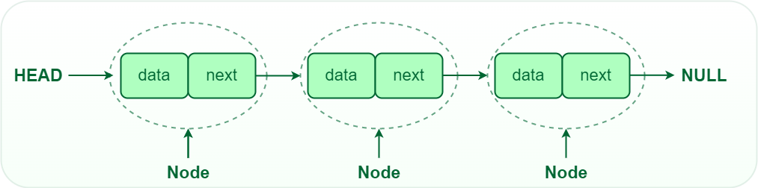
1. Single-linked list:
In a singly linked list, each node contains a reference to the next node in the sequence. Traversing a singly linked list is done in a forward direction.

Slide 13
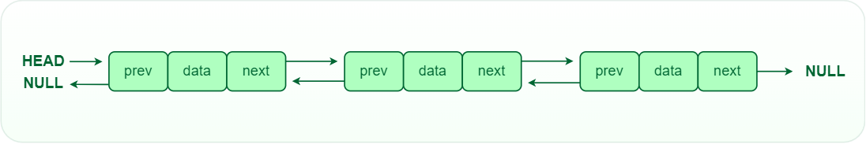
2. Doubly -linked list:
In a doubly linked list, each node contains references to both the next and previous nodes. This allows for traversal in both forward and backward directions, but it requires additional memory for the backward reference.

Slide 14
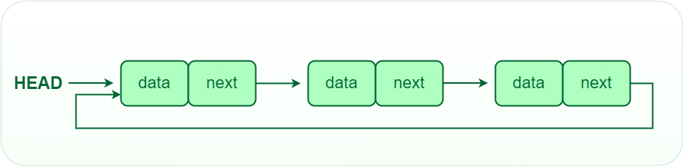
3. Circular -linked list:
In a circular linked list, the last node points back to the head node, creating a circular structure. It can be either singly or doubly linked.

Slide 15
Basic on operations on Linked List
Insertion: Adding a new node to a linked list involves adjusting the pointers of the existing nodes to maintain the proper sequence. Insertion can be performed at the beginning, end, or any position within the list
Deletion: Removing a node from a linked list requires adjusting the pointers of the neighboring nodes to bridge the gap left by the deleted node. Deletion can be performed at the beginning, end, or any position within the list.
Searching: Searching for a specific value in a linked list involves traversing the list from the head node until the value is found or the end of the list is reached.
Display :

Slide 16
1. INSERTION OPERSTION :
Insertion in linked list can be done in three different ways. They are :
Insertion at the beginning of the linked List.
Insertion at the end of Linked List
Insertion at Specified position

Slide 17
Algorithm for Insertion at beginning of the linked List
Step -1. START
Step -2. Create a new node with pointer - p
Step -3. Set p->data = element
Step -4. If (head = NULL)
Set head =p.
else
Set p->next = head
Set head = p
Step - 6. END

Slide 18
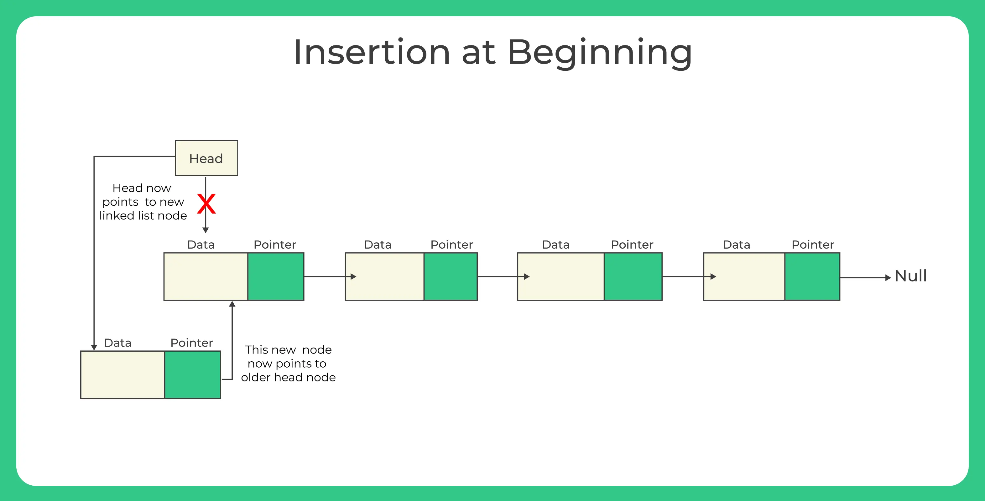

Slide 19
Algorithm for Insertion at end of the linked List
Step -1. START
Step -2. Create a new node with pointer - p
Step -3. Set p->data = element
Set p->next = NULL
Step -4. Set temp=head
Step -5 While (temp-next !=NULL)
Set temp=temp->next
Step -6. Set temp->next = p
Step -7. END

Slide 20
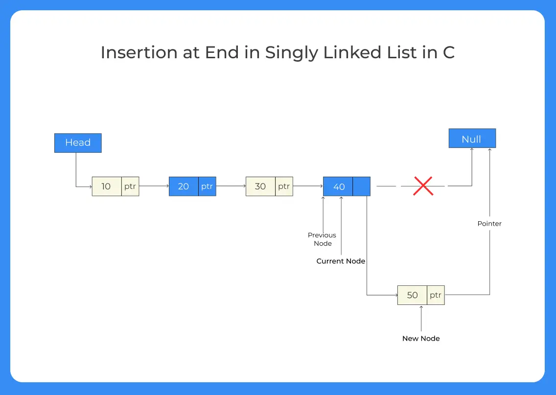

Slide 21
Algorithm for Insertion at Specified position for X in the linked List i.e .Ordered list
Step -1. START
Step -2. Create a new node with pointer - p
Step -3. Set p->data = element // fill data into node
Set p->next = NULL
Step -4. if (head = NULL) // case-1 Linked List empty
Set head = p
else if( x <= head->data) // case-2 inserting smallest/beginning
Begin
Set p->next =head
Set head=p
end

Slide 22
Algorithm continued.......
else Begin // other than case-1 and case-2 inserting smallest
Set prev = head
Set curr =head->next
while(curr && x >= curr->data)
Begin
Set prev=prev->next
Set curr=curr->next
end
Set prev->next =p
Set p->next = curr
end
Step -5. END.

Slide 23
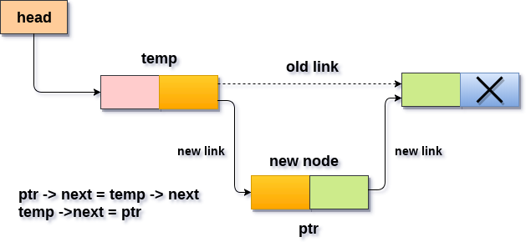
Algorithm for Insertion at a specifed point in the Single linked List (Not an Ordered list)

Slide 24
Step -1. START
Step -2. Create a new node with pointer - p
Step -3. Set p->data = element // fill data into node
Set p->next = NULL
Step -4. Set temp=head
Step -5 if(head == NULL) // Inserting First node
Set head = p

Slide 25
else Begin
print " Specify the Location of insertion “
Read loc
for i = 0 to loc-1
Begin
Set temp = temp->next
if(temp == NULL)
Begin
printf “can't insert”
return
end
end

Slide 26
Set p->next = temp->next;
Set temp ->next = p;
print "Node inserted"
end
Step -6. End

Slide 27
Algorithm for Deletion from the beginning of the linked List
Step -1. START
Step -2. Set temp=head
Step -3. Set x=temp->data
Step -4. Set head=head->next
Step -5. free(temp)
Step - 6. return x

Slide 28
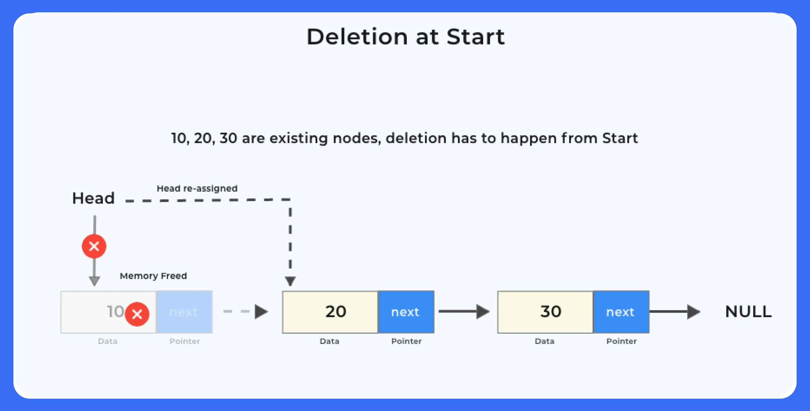

Slide 29
Algorithm for Deletion at end of the linked List
Step -1. START
Step -2. Set temp = head
Step -3. if (temp==NULL)
print “Linked List is empty” Goto 6
else if (temp->next==NULL)
Begin
Set x = temp->data
Set head=NULL
free(temp)
end Goto 5
else While (temp->next !=NULL) //reach second last elemnt
Begin
Set prev=temp
Set temp=temp->next
End

Slide 30
Algorithm for Deletion at end of the linked List
Step -4. Set x=temp->data
Set prev->next = NULL
free(temp)
Step -5. print “ x has been deleted “
Step -6. End

Slide 31
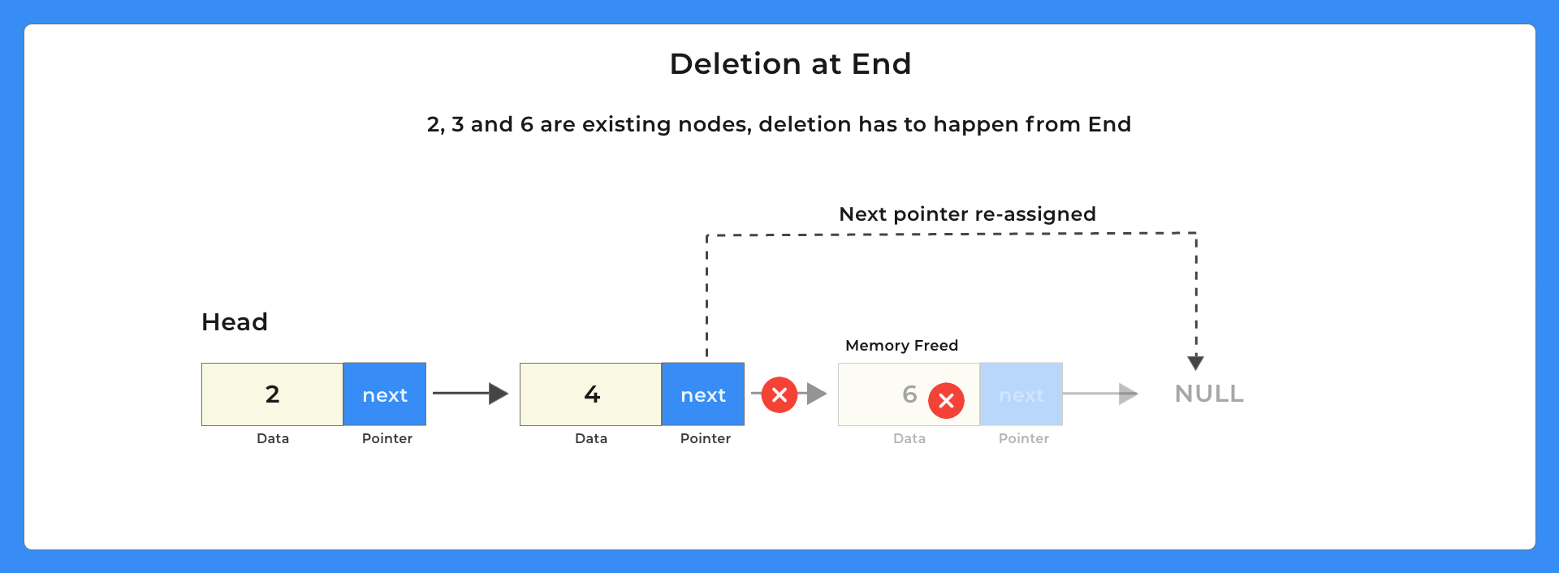

Slide 32
Algorithm for Deletion of specified Element -x in the Ordered List
Step -1. START
Step -2. if (head==NULL)
print “Linked List is empty” Goto 7
else if (head->data == x)
Begin
print “ head->data/x has been deleted "
Set temp=head
Set head=head->next
free(temp)
End

Slide 33
Algorithm Continued.......
else Begin
Set prev=head
Set curr=head->next
while(curr and x !=curr->data )
Begin
Set curr=curr->next
Set prev=prev->next
end

Slide 34
if(curr)
begin
Set temp=curr
Set curr=curr->next
Set prev->next =curr
print “temp->data/x has been deleted “
free(temp)
end
else
print " x is not found in the linked list”
end
Step-4 End

Slide 35
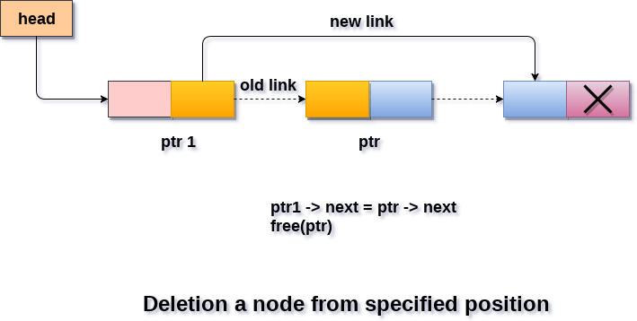
Algorithm for Deletion at the specified point in the Single linked List -(Not an Ordered List)

Slide 36
Step -1. START
Step -2. print " Enter Location of specified node “
Step -3. Read loc
Step -4. Set ptr=head
Step -5. if(head->next ==NULL) // case-1 Linked list has only one element
Begin
print “ head->data has been Deleted”
Set head=NULL
return
end

Slide 37
else if(loc==0) // case-2 deletion of a node when loc is zero Begin
print " head-data has been Deleted “
Set head=head->next
free(ptr)
end

Slide 38
else Begin
for i=0 to loc-1
Begin
Set ptr1 = ptr // ptr1 is a poniter to a previous node of a node being deleted
Set ptr = ptr->next // ptr is a poniter to node being deleted
if(ptr == NULL)
Begin
print “ Deletion not possible”
return
end
End

Slide 39
set ptr1 ->next = ptr ->next;
print “ ptr-data has been deleted “
free(ptr)
end
Step -6. End

Slide 40
Circular
Single Linked List

Slide 41
Circular Singly Linked List
In a circular Singly linked list, the last node of the list contains a pointer to the first node of the list.
We can have circular singly linked list as well as circular doubly linked list.
We traverse a circular singly linked list until we reach the same node where we started.
The circular singly liked list has no beginning and no ending. There is no null value present in the next part of any of the nodes.
The following image shows a circular singly linked list.

Slide 42
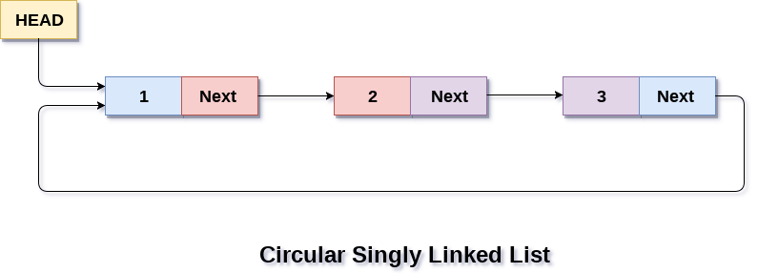
Applications :
Circular lists can be used for applications in which the entire list is
accessed in a loop.
2. It can also be used by the Operating System to share time with
different users. Generally, it uses a Round Robin time-sharing
method.
3. Multiplayer games utilize a circular list to switch between players
in a loop.

Slide 43
Applications of Circular List continued....
4. Implementation of advanced data structures such as Fibonacci
Heap.
5. You can access the browser cache by hitting the BACK key.
6. In Photoshop and Word, you can undo the functionality.
7. Round Robin Scheduling uses circular linked lists.

Slide 44
1. INSERTION OPERATION :
Insertion in Circular linked list can be done in three different ways. They are :
Insertion at the beginning of the Circular linked List.
Insertion at the end of Circular Linked List
Insertion at Specified position of a Circular Linked List

Slide 45
Algorithm for Insertion at beginning of the Circular linked List
Step -1. START
Step -2. Create a new node with pointer - p
Step -3. Set p->data = element
Step -4. If (head = NULL)
Set head =p.
Set p->next = head
else Begin
Set temp = head
while(temp->next != head)
Set temp = temp->next

Slide 46
Set p->next = head
Set temp -> next = p
Set head = p
end
Step - 6. END

Slide 47
Algorithm for Insertion at end of the Circular linked List
Step -1. START
Step -2. Create a new node with pointer - p
Step -3. Set ptr->data = item
Step -4. if(head == NULL)
begin
Set head = p
Set p -> next = head
end
else begin
Set temp = head
while(temp -> next != head)
Set temp = temp -> next

Slide 48
Set temp -> next = p
Set p -> next = head
end
Step - 5. END

Slide 49
1. DELETION OPERATION :
DELETION in Circular linked list can be done in three different ways. They are :
Deletion at the beginning of the Circular linked List.
Deletion at the end of Circular Linked List
Deletion at Specified position of a Circular Linked List

Slide 50
Algorithm for Deletion at beginning of the Circular linked List
Step -1. START
Step -2. Create a new node with pointer - p
Step -3. Set p=head
Step -4 if(head==NULL)
print "Linked List is empty” Goto step 6
else if(head->next == head)
Begin
Set x=head->data
Set head=NULL
free(head)
end

Slide 51
else Begin
Set x=p->data;
Set temp=head;
while(temp->next !=head)
Set temp=temp->next
Set head=head->next
Set temp->next=head
free(p)
end
Step - 6. print “ X has been deleted “
Step - 7. END

Slide 52
Algorithm for Deletion at end of the Circular linked List
Step -1. START
Step -2. Create a new node with pointer - p
Step -3. if(head==NULL)
print “Linked List is empty " Goto Step 6
else if(head->next == head)
Begin
Set x=head->data;
Set head=NULL;
free(head);
End

Slide 53
else Begin
Set prev=head;
Set curr=head->next;
while(curr->next !=head)
Begin
Set curr=curr->next
Set prev=prev->next
end
Set prev->next=head;
Set x=curr->data
free(curr)
end

Slide 54
Step - 4. print “ X has been deleted”
Step - 5. END

Slide 55
Algorithm for Insertion and Deletion at the specified position of Circular linked List is same as that of Single ordered List

Slide 56
Doubly
Linked List

Slide 57
3. Doubly linked list
In a singly linked list, we could traverse only in one direction, because each node contains address of the next node and it doesn't have any record of its previous nodes.
However, doubly linked list overcome this limitation of singly linked list.
Due to the fact that, each node of the list contains the address of its previous node, we can find all the details about the previous node as well by using the previous address stored inside the previous part of each node.

Slide 58
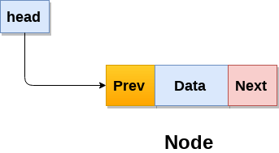
3. Doubly linked list
Doubly linked list is a complex type of linked list in which a node contains a pointer to the previous as well as the next node in the sequence.
Therefore, in a doubly linked list, a node consists of three parts: 1. node data,
2. pointer to the next node in sequence (next pointer) ,
3. pointer to the previous node (previous pointer).
A sample node in a doubly linked list is shown in the following figure.

Slide 59
In C, structure of a node in doubly linked list can be given as :
struct node
{
struct node *prev;
int data;
struct node *next;
}
The prev part of the first node and the next part of the last node will always contain null indicating end in each direction.

Slide 60
Memory Representation of a doubly linked list
Memory Representation of a doubly linked list is shown in the following image.
Generally, doubly linked list consumes more space for every node and therefore, causes more expansive basic operations such as insertion and deletion.
However, we can easily manipulate the elements of the list since the list maintains pointers in both the directions (forward and backward).

Slide 61
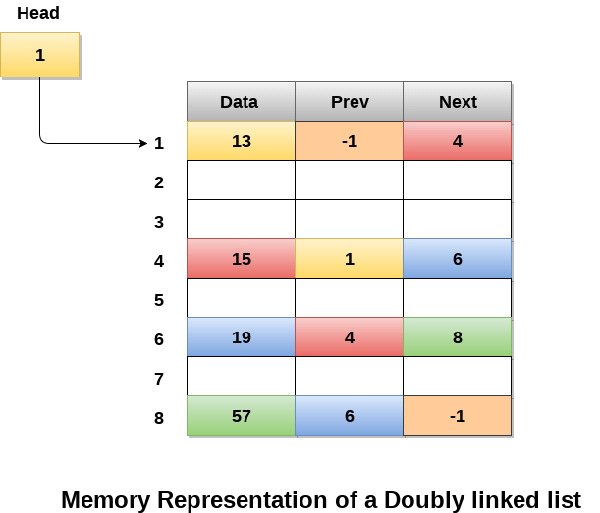
As shown in the above figure,
the first element of the list that is i.e. 13 stored at address 1. The head pointer points to the starting address 1.
Since this is the first element being added to the list therefore the prev of the list contains null.
The next node of the list resides at address 4 therefore the first node contains 4 in its next pointer.

Slide 62
Advantages of Doubly Linked List
Due to the next and prior pointers, it supports traversing in both ways compared to the singly linked list (which only supports one direction).
Node deletion is simpler than it will be in a singly linked list, and this is because we will need access to the node that came before it to remove a node. Hence, two pointers are required for deletion in a singly linked list. As in a doubly linked list, each node already has the information of the preceding node, eliminating the need for an additional pointer.
It is also easy to reverse a doubly linked list. A doubly-linked list may be reversed by switching the next & previous pointers for each node and updating the head node to point to the last node.
A new node may be readily added before an existing node

Slide 63
Disadvantages of Doubly Linked List
Because it must have an additional previous pointer for each node, it uses more memory than a singly linked list.
The list's elements can only be accessed sequentially since they are stored in random places and cannot be accessed randomly.
Due to the expense of managing more pointers, all operations take more time. For instance, modifying the previous and next pointers is necessary when adding a new node, and it is also essential when deleting a node.

Slide 64
Applications of Doubly Linked List
It is applied by navigation systems when forward and back navigation is required.
The browser utilizes a back & forward button to provide backward & forward navigation of accessed web pages.
Additionally, a traditional gaming deck of cards is used to represent it.
Numerous programs also utilize it to add capabilities for undoing and redoing actions.
MRU/LRU (most/least recently used) cache construction also uses a doubly linked list
A doubly-linked list can build or program other data structures such as stacks, hash tables, and binary trees.

Slide 65
1. INSERTION OPERATION :
Insertion in Doubly linked list can be done in three different ways. They are :
Insertion at the beginning of the Doubly linked List.
Insertion at the end of Doubly Linked List
Insertion at Specified position of a Doubly Linked List

Slide 66
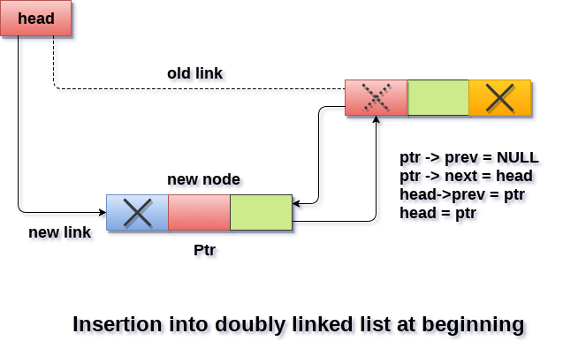
Algorithm for Insertion at beginning of the Doubly linked List

Slide 67
Algorithm for Insertion at beginning of the Doubly linked List
Step -1. START
Step -2. Create a new node with pointer - p
Step -3. Set p->data = element
Step -4. if (head == NULL)
Begin
Set p->next = NULL;
Set p->prev = NULL;
Set head = p
End

Slide 68
else Begin
Set p->prev=NULL
Set p->next = head
Set head->prev=p
Set head=p
End
Step - 6. END

Slide 69
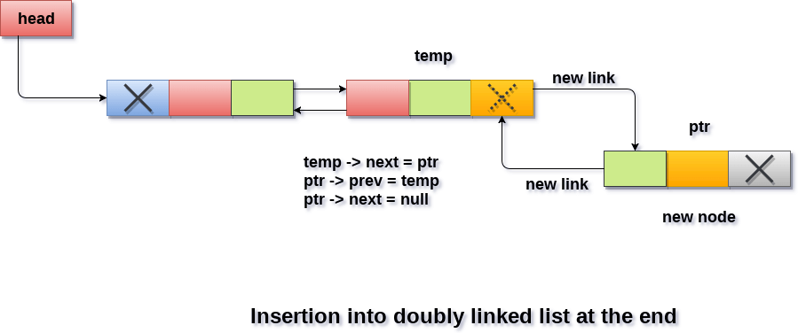
Algorithm for Insertion at the end of the doubly linked List

Slide 70
Algorithm for Insertion at the end of the doubly linked List
Step -1. START
Step -2. Create a new node with pointer - p
Step -3. Set p->data = element
Step -4. if (head == NULL)
Begin
Set p->next = NULL;
Set p->prev = NULL;
Set head = p
End

Slide 71
else Begin
Set temp=head
while(temp->next !=NULL)
Set temp=temp->next
Set temp->next = p
Set p->prev=temp
Set p->next=NULL
Step - 6. END

Slide 72
1. DELETION OPERATION :
Deletion in Doubly linked list can be done in three different ways. They are :
Deletion at the beginning of the Doubly linked List.
Deletionat the end of Doubly Linked List
Deletion at Specified position of a Doubly Linked List

Slide 73
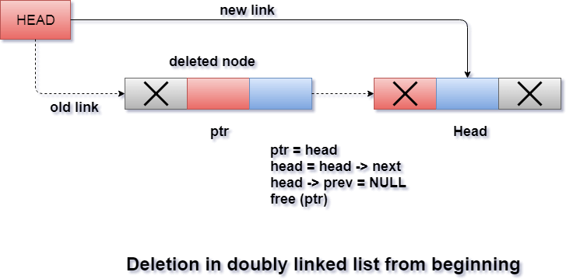
Algorithm for Deletion at beginning of the Doubly linked List

Slide 74
Algorithm for Deletion at beginning of the Doubly linked List
Step -1. START
Step -2. Setp=head
Step -3. Set x=p->data
Step -4. if(head->next ==NULL && head->prev==NULL)
Begin
Set head=NULL;
Set return x
end

Slide 75
else Begin
Set head=head->next
Set head->prev=NULL
free(p)
return x
Step -5. END

Slide 76
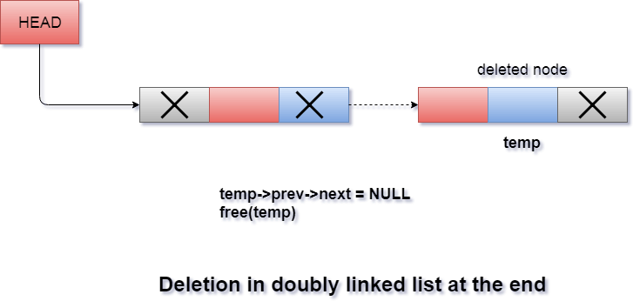
Algorithm for Deletion at end of the Doubly linked List

Slide 77
Algorithm for Deletion at end of the Doubly linked List
Step -1. START
Step -2. Set temp=head
Step -5. if(head->next ==NULL && head->prev==NULL)
Begin
Set x=temp->data;
Set head=NULL;
return x
End

Slide 78
Algorithm for Deletion at end of the Doubly linked List continued....
else Begin
while(temp->next!=NULL)
Set temp=p->next
Set temp->prev->next=NULL
Set x=p->data
free(temp)
return x
Step -2. End

Slide 79
STACK Implementation Using LINKED LIST
Function Prototype Design
void Push()
void Pop()
void Display_Stack()

Slide 80
Algorithm PUSH()-Operation: Step -1. START
Step -2. Create a new node with pointer - p
Step -3. Set p->data = element
Step -4. if(p==NULL)
Begin
printf “Memory allocation not possible”
return
End
Step -5. Set p-> next = stack_top
Set stack_top=p Step-6: END

Slide 81
Algorithm POP()-Operation: Step -1. START
Step -2. Set temp=stack_top
Step -3. if(temp=NULL)
printf "Stack is Empty " goto step 4
else begin
print “The popped element is temp->data”
Set stack_top = stack_top->next
free(temp)
Step-4: END

Slide 82
Algorithm Display-Strack() -Operation: Step -1. START
Step -2. Set p=stack_top;
Step -3. if(p==NULL)
print “Stack is Empty " goto step 4
else Begin
printf " STACK contents are : “
while(p!=NULL)
Begin
print "p->data”
Set p=p->next
end
Step -4 End

Slide 83
Queue Implementation Using LINKED LIST
Function Prototype Design
void Enqueue(int item)
int Dequeue()
void Display_Queue()

Slide 84
Algorithm for EnQueue(int item) operation
Note : Initially front and rear are ponting to NULL
Step -1. START
Step -2. Create a new node with pointer - p
Step -3. Set p->data = item
Step -4. Set p->next =NULL
Step -4. If (rear = NULL and Front = NULL) // First item in queue
Set front = Rear = p
else
Set rear->next = p // Susequent items in queue
Set rear= p
Step - 6. END

Slide 85
Algorithm for Dequeue(int item) operation
Step -1. START
Step -2. If (rear = NULL and Front = NULL)
print “Queue is Empty” return NULL
else
Set x=front->data
Set temp = front
Set front = front->next
Step -3. If (Front = NULL) // After deletion of LAST item from queue
Set rear=NULL
Step -4. free(temp)
Step -6. return x

Slide 86
Algorithm for Display_Queue() operation
Step -1. START
Step -2. If (rear = NULL and Front = NULL)
print “Queue is Empty” Goto 5
Step -3. Set temp =front
Step -4. While (temp != NULL)
print temp->data
set temp = temp->next
Step -5. END

Slide 87
END of UNIT - 3

